Slide 1



BEYOND CODING — 2026
✦
PRESENTATION
Beyond Coding
The Power of Web Development & Software Testing
Building better websites through development, testing, and quality assurance.
WEB DEVELOPMENT
SOFTWARE TESTING
QUALITY ASSURANCE

Slide 2
✦
SLIDE 02 — FUNDAMENTALS
Understanding the Two Worlds
Two disciplines that together define any successful digital product — each one completes the other.
✦
✓
01 — DISCIPLINE
02 — DISCIPLINE
Web Development
Software Testing
The process of designing and building websites and web applications.
The process of evaluating software to identify defects and ensure quality.
KEY RESPONSIBILITIES
KEY RESPONSIBILITIES
✓Creating responsive user interfaces.
✓Writing clean and maintainable code.
✓Implementing website functionality.
✓Connecting front-end interfaces with back-end services.
✓Improving website performance.
✓Verifying website functionality.
✓Identifying bugs and defects.
✓Testing user interactions.
✓Validating data and system behavior.
✓Ensuring a consistent user experience.
02 / 12

Slide 3
⇄
SLIDE 03 — INTERSECTION
Where Development Meets Testing
Development and testing are not separate activities. They complement each other throughout the software development lifecycle.
✦ WEB DEVELOPMENT | ✓ SOFTWARE TESTING
Builds website features | Verifies features work
Implements business logic | Validates business logic
Handles user interactions | Tests user interactions
Fixes coding issues | Detects and reports defects
Improves performance | Evaluates performance
✦
The result:
Better functionality, fewer defects, and higher product quality.
03 / 12

Slide 4


INSIDE THE MIND
◯
SLIDE 04 — FOR DEVELOPERS
of a Developer
Why Developers Need Testing Skills
A developer who understands testing can build more reliable applications.
THE BENEFITS
⌕
Identifying potential issues during development.
✦
Writing code with testability in mind.
◯
Understanding edge cases and unexpected user behavior.
◔
Reducing debugging time.
⚒
Improving code quality and maintainability.
Good developers don't just ask: Does it work?
They also ask: What could go wrong?
04 / 12

Slide 5



#
SLIDE 05 — FOR TESTERS
INSIDE THE MIND
of a Tester
Why Testers Need Development Skills
Understanding web development helps testers go beyond checking the visible interface.
THE BENEFITS
✦
Understanding HTML, CSS, and JavaScript.
⚒
Identifying potential sources of defects.
⇄
Understanding client-server communication.
♟
Working effectively with developers.
✦
Testing APIs and application behavior more efficiently.
A tester who understands how apps are built…
…can investigate problems more effectively.
05 / 12

Slide 6
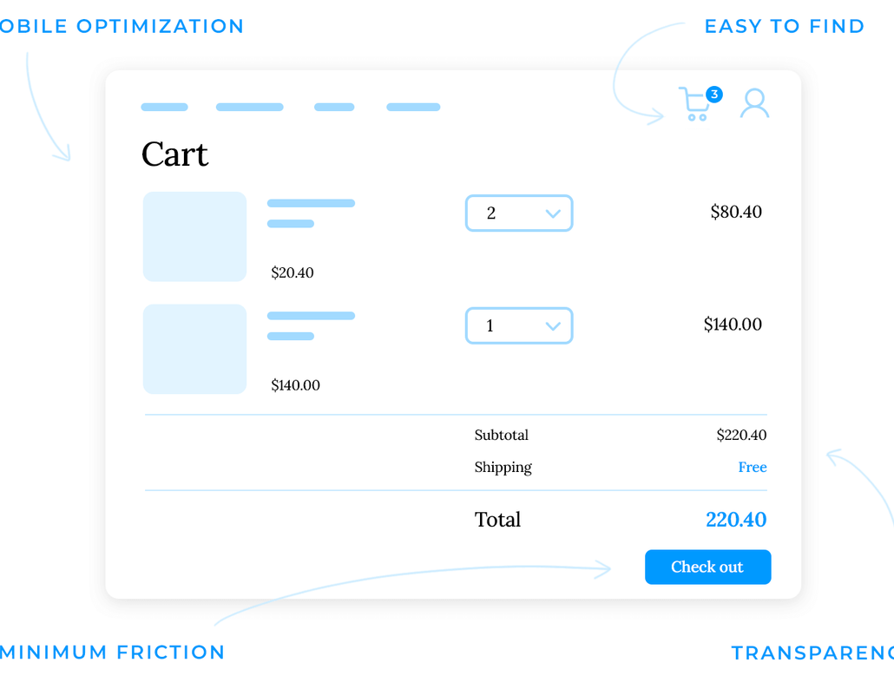


#
SLIDE 06 — CASE STUDY
Practical Example: E-Commerce Website
Let’s consider an online shopping website.
✦
DEVELOPMENT TASKS
Build the user interface.
Implement shopping cart functionality.
Connect the website to APIs.
Handle user input and data.
✓
TESTING TASKS
Verify registration and login.
Check product selection.
Validate cart calculations.
Test checkout functionality.
Verify order confirmation.
WEBSITE COMPONENTS
User Registration & Login
Product Listings
Product Details
Shopping Cart
Checkout Process
Order Confirmation
06 / 12

Slide 7

#
SLIDE 07 — WORKFLOW
From Development to Testing
Consider a simple shopping cart feature.
01
✦
02
✓
03
✓
Development
Testing
Expected Outcome
The developer creates functionality that allows users to add products to the cart and calculate the total price.
THE TESTER VERIFIES:
The shopping cart should work accurately under different user scenarios.
Products are added successfully.
Product quantities can be updated.
The cart calculates the correct total.
Removing a product updates the total.
The user proceeds to the correct checkout page.
→
→
STAGE ONE
✓
VERIFIED
07 / 12

Slide 8
#
SLIDE 08 — CASE STUDY
Finding and Fixing Bugs
When the math doesn’t add up.
⚠
SCENARIO:
Imagine a customer adds two products to the shopping cart.
Product A = $50
+
Product B = $30
→
Expected = $80
Actual = $70 ✗
▤
BUG REPORT EXAMPLE
⚒
THE PROCESS
Bug Title | Incorrect Cart Total
Module | Shopping Cart
Severity | High
Priority | High
Expected Result | Total should be $80
Actual Result | Total displays $70
Status | Open
1
Tester identifies the defect.
2
Tester documents the issue.
3
Developer investigates the code.
4
Developer fixes the defect.
5
Tester performs Retesting.
6
Tester performs Regression Testing.
08 / 12

Slide 9
SLIDE 09 — TOOLBOX
Tools That Connect Both Fields
Different tools support development and testing activities — each one serves a specific purpose in the workflow.
✦
✦
✦
✦
HTML
CSS
JavaScript
Git & GitHub
Structuring web pages.
Styling and responsive layouts.
Adding interactivity.
Version control and collaboration.
DEV
DEV
DEV
COLLAB
➤
✦
✓
✦
Postman
Selenium
Jira
Chrome DevTools
API testing.
Browser automation.
Bug tracking and task management.
Debugging and inspecting web applications.
TEST
TEST
COLLAB
DEV
09 / 12
◆
Using the right tools improves collaboration and productivity.

Slide 10

SLIDE 10 — INTEGRATION
The Power of Combined Skills
Combining web development and software testing creates several advantages.
360°
+50%
−40%
Full-Stack Vision
Faster Collaboration
Fewer Defects
Complete understanding of the application.
Dev ↔ Tester communication enhanced.
Early detection and resolution.
KEY ADVANTAGES
◉
Better understanding of the complete application.
◌
Improved communication between developers and testers.
✦
Faster defect identification and resolution.
▤
More effective testing strategies.
☻
Better user experience.
✓
Higher software quality.
✦
One product. Two perspectives. One quality goal.
10 / 12

Slide 11



SLIDE 11 — CULTURE
Quality Is a Team Effort
Software quality is not the responsibility of testers alone — it's a collective effort across the entire team.
✦
✓
♟
Developers
Testers
CONTRIBUTION
CONTRIBUTION
Together
Contribute by writing reliable code.
Evaluate functionality and identify defects.
COLLABORATION
Work together to deliver a product that meets user expectations.
✓
Clean, maintainable code
✓
Comprehensive functional tests
✓
Unit tests written
✓
Realistic user scenarios
✓
Shared quality vision
✓
Integrated problem-solving
♛
Quality should be built into the development process, not added at the end.
11 / 12

Slide 12


SLIDE 12 — CONCLUSION
Build It Right. Test It Well. Deliver Quality.
✦
✓
✦
Development
Testing
Together
Creates the product.
Evaluates its reliability.
Transform an ordinary website into a dependable digital experience.
Better Development • Smarter Testing • Higher Quality
12 / 12

